Slide 1

Electronic & Embedded Systems
Lecture 03
- Logic gates &
Digital electronic
Brice PARILUSYAN
PhD Student
brice.parilusyan@gmail.com

Slide 2

Course overview
01|
Logic gates
02|
Sequential logic
03|
Digital electronic
04|
Practice

Slide 3

Logic gates
Digital electronic basics
Main gates
Exercises

Slide 4
1|
Logic gates
Digital electronic basics
Digital Waveform
Data shape
Transistor assembly

Slide 5
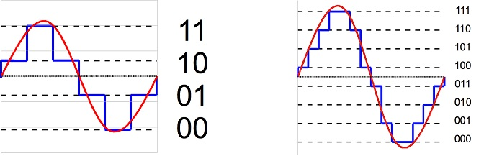
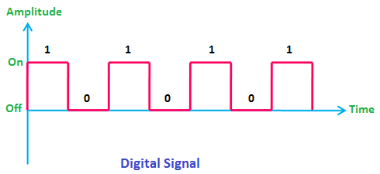
1|
Logic gates
Digital waveform
Definition:
Digital signal is the result of conversion of a continuous signal to a discrete signal. In digital electronics, there are only two voltage states present at any point within a circuit, high or low.
The high and low states can be represented as true and false statements, which are used in Boolean logic. In most cases, high equals true and low equals false.

Slide 6
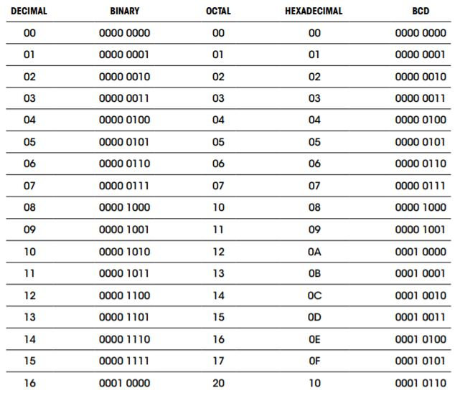
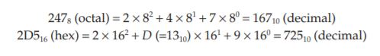
1|
Logic gates
Data shape
Definition :
Binary is a data encoding who use the only 2 states of digital electronic (High and low).
Octal is a data encoding on base 8. It means there are only 8 digit allowed. 0,1,2,3,4,5,6,7
Hexadecimal is a data encoding on base 16. It means there are 16 digit allowed. 0,1,2,3,4,5,6,7
,8,9,A,B,C,D,E,F

Slide 7
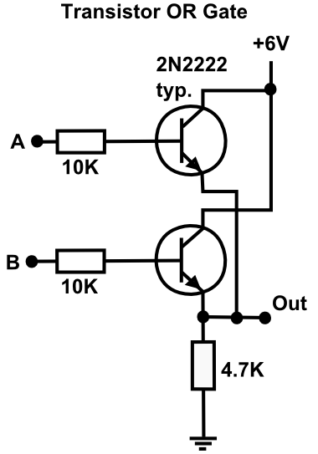
1|
Logic gates
Transistor assembly
Definition :
A logic gate is a component assembly designed to output specific signals depending of the input. Most of them are made from transistors. Logic gate are the building block of digital electronics

Slide 8
1|
Logic gates
Main gates
Truth table
NOT gates
OR gates
AND gates
NOR gates
NAND gates
XOR gates

Slide 9
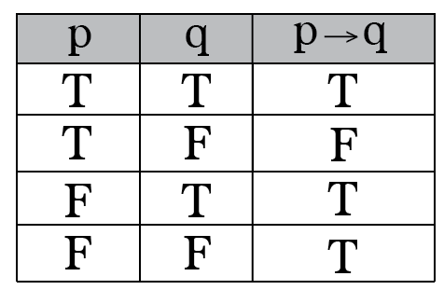
1|
Logic gates
Truth table
Definition :
A truth table is a mathematical table used in logic which express all the results of a function, considering the entry values possibilities.
In this example, we have the truth table of an unknow function. What can extract from it is the result considering the two-entry p and q

Slide 10
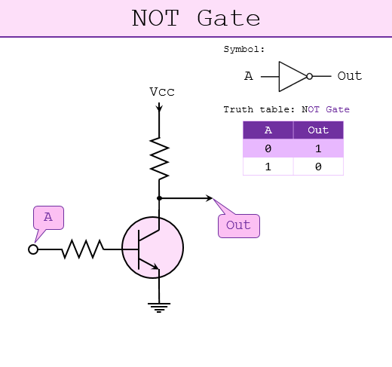
1|
Logic gates
NOT gates
Definition :
NOT gates, or invertor gates, is a gate who invert any signals use as input.

Slide 11
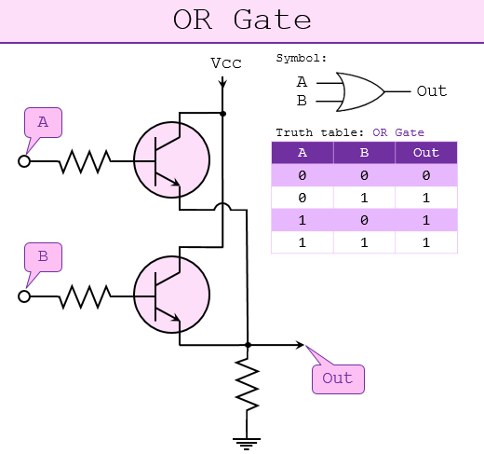
1|
Logic gates
OR gates
Definition :
OR gates output a high level in any case but if all the input are low.

Slide 12
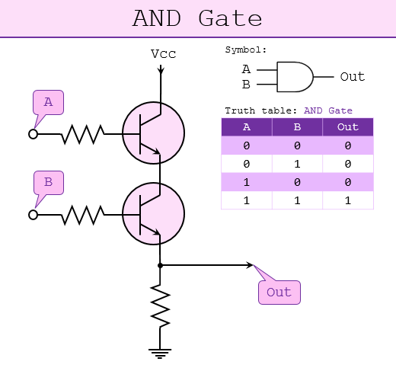
1|
Logic gates
AND gates
Definition :
AND gates output a low level in any case but if all the input are high.

Slide 13
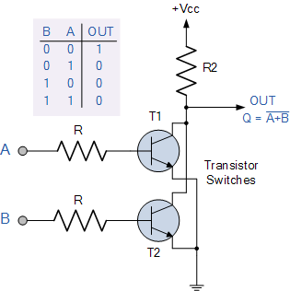
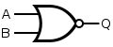
1|
Logic gates
NOR gates
Definition :
NOR gates are OR gates with all the output inverted.

Slide 14
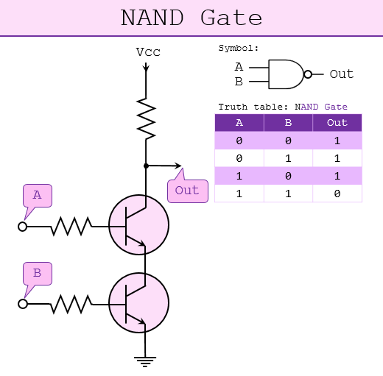
1|
Logic gates
NAND gates
Definition :
NAND gates are AND gates with all the output inverted.

Slide 15
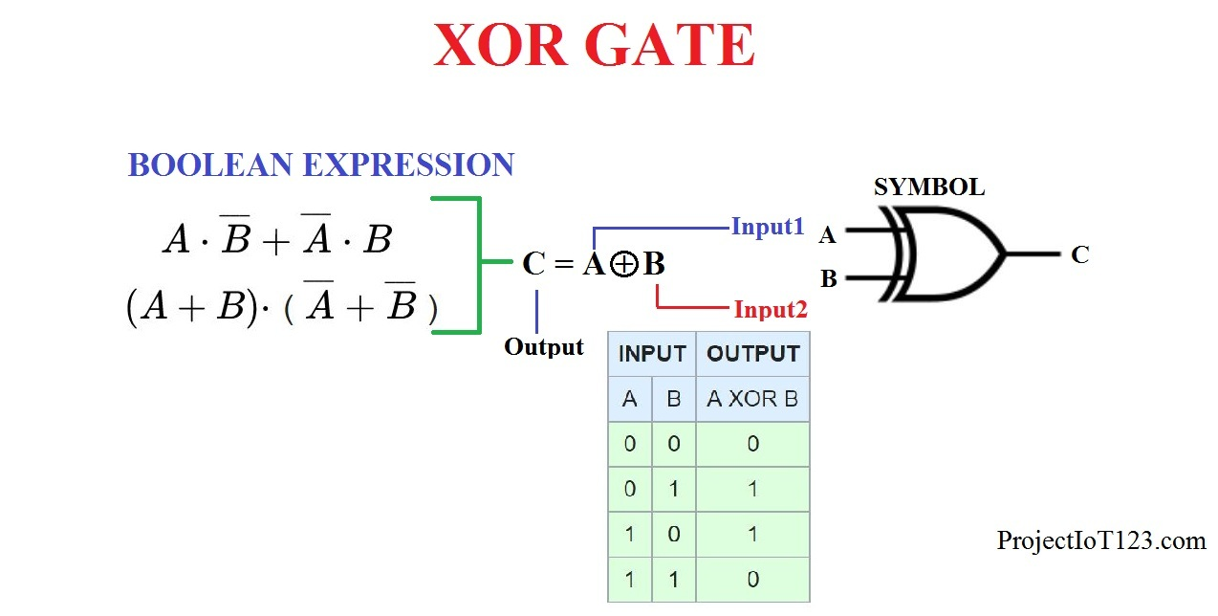
1|
Logic gates
XOR gates
Definition :
XOR gates are OR gates with all the output inverted and an exclusive expression added. It means if all the input are high, then the output is low automatically.

Slide 16
1|
Logic gates
Exercises

Slide 17
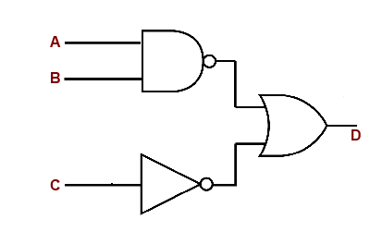
1|
Logic gates
Define the truth table of the following circuit :

Slide 18
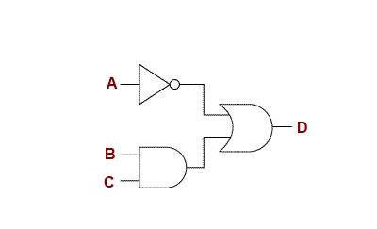
1|
Logic gates
Define the truth table of the following circuit :

Slide 19

Sequential logic
Logic gates assembly
Practice

Slide 20
2|
Sequential logic
Logic gates assembly
SR Latch
D Latch
D Flip-flop
JK Flip-flop

Slide 21
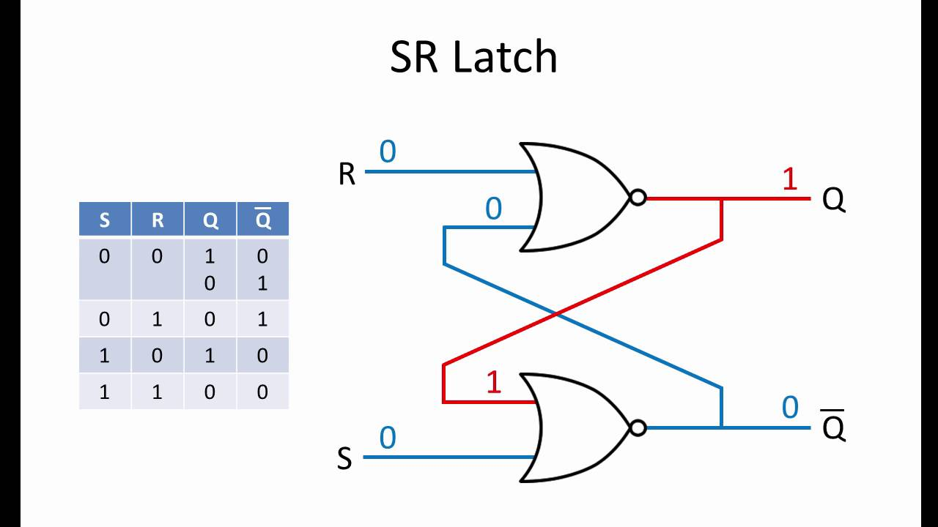
2|
Sequential logic
SR latch
Definition :
Sequential logic refer to circuits who compensate a lack of memory from combinational circuit. They are able to store information.
An SR latch is a sequential logic circuit who store a bit of information.

Slide 22
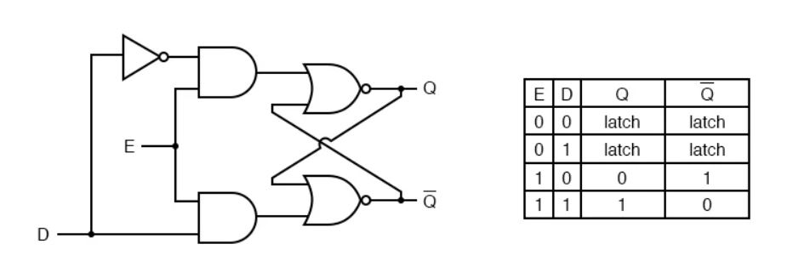
2|
Sequential logic
D latch
Definition :
D latch is an upgrade version of the SR-latch. It eliminate the “illegal” input states. With a D latch, you can write an information only if you put the enable pin to high.

Slide 23
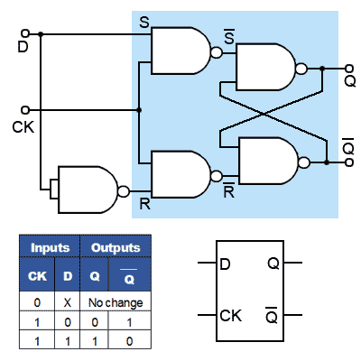
2|
Sequential logic
D flip-flop
Definition :
D type flip-flop is referencing to a D latch logic gates, pulsed by a periodic signal named clock.

Slide 24
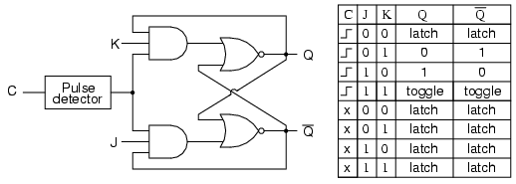
2|
Sequential logic
JK flip-flop
Description :
JK flip-flop is the last kind of assembly. A JK flip-flop resembles an SR flip-flop, where J acts like S and K acts like R. Likewise, it has a set mode (J = 1, K = 0), a reset mode (J = 0, K = 1), and a hold mode (J = 0, K = 0). However, unlike the SR flip-flop, which has an indeterminate mode when S = 1, R = 1, the JK flip-flop has a toggle mode when J = 1, K = 1. Toggle means that the Q and no-Q outputs switch to their opposite states at each active clock edge.

Slide 25
2|
Sequential logic
Practice

Slide 26
2|
Sequential logic
Recreate a D-latch

Slide 27
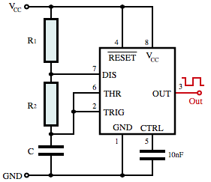
2|
Sequential logic
Add a NE555 to generate a clock to E !

Slide 28

Digital electronic
Binary
Digital arithmetic

Slide 29
3|
Digital electronic
Binary
Binary conversion
Octal & Hexadecimal
Adding
Subtracting
Clock
ASCII

Slide 30
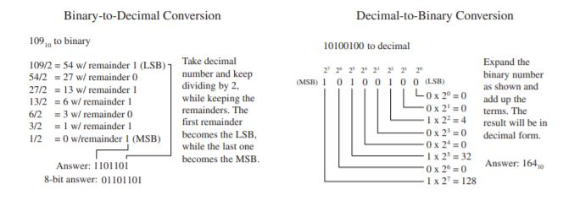
3|
Digital electronic
Binary conversion
Exercises :
1) Represent the following base 10 numbers as a byte : 208, 122, 42, 17,70,13
2) Represent the following byte as base 10 numbers : 00110111, 01001110, 00100000, 01110101, 11001000

Slide 31
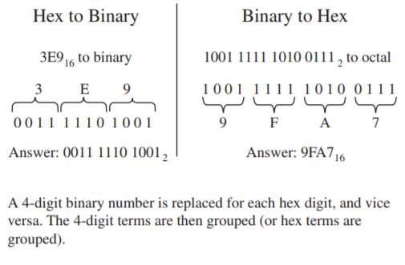
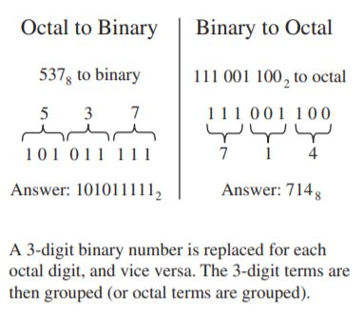
3|
Digital electronic
Octal & Hexadecimal
Exercise :
1) Convert the following base 10 numbers in octal then hexadecimal: 208, 122, 42, 17,70,13
2) Convert the following byte octal and hexadecimal: 00110111, 01001110, 00100000, 01110101, 11001000

Slide 32
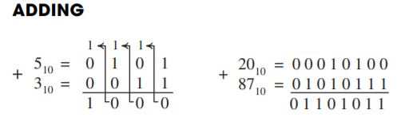
3|
Digital electronic
Adding
Definition :
Adding binary numbers is just like adding decimal numbers. Whenever the result of adding one column of numbers is greater than one digit, a 1 is carried over to the next column to be added.
Example :
01100101 + 00001101
01010101 + 10101010
11001010 + 00101101

Slide 33
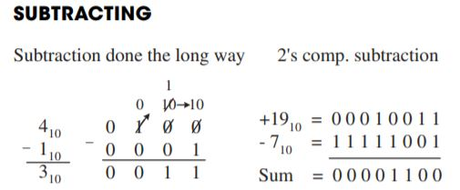
3|
Digital electronic
Subtracting
Definition :
Binary subtraction is tedious, it is like decimal subtraction but can be confusing. The trick to subtracting binary numbers is to invert the subtractor and add 1 to it. Then adding the result with subtracted. The supplementary bit is the sign bit (0 = -, 1 = +).
My personal trick -> be lazy, convert it in base 10, subtract then convert the result in binary

Slide 34
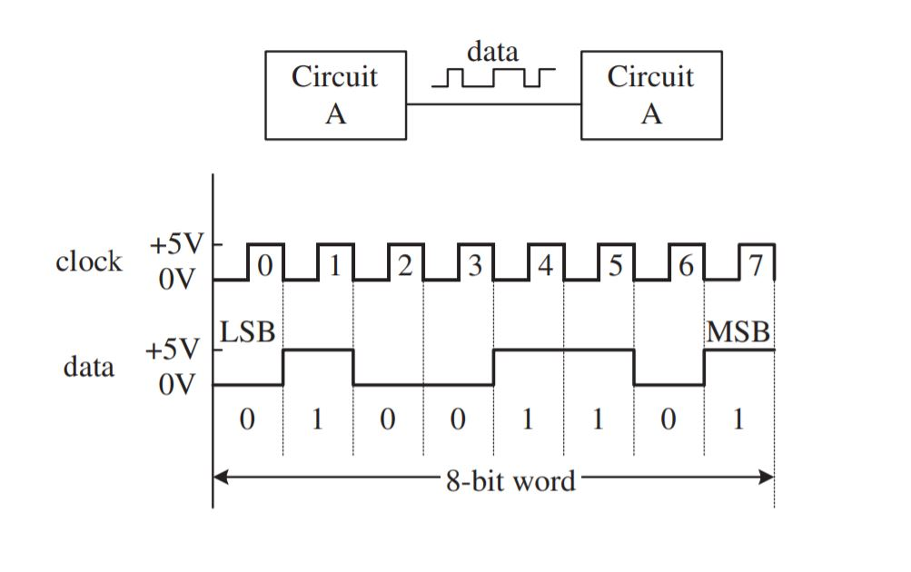
3|
Digital electronic
Clock
Definition :
The clock is a periodic digital signal who manage the timing of the operations. Each CPU need to have a clock frequency (generally created by a crystal). When two devices work together, they need to share their clock pulse in order to be synchronous. Higher is the clock frequency, Higher is the speed processing of the component

Slide 35
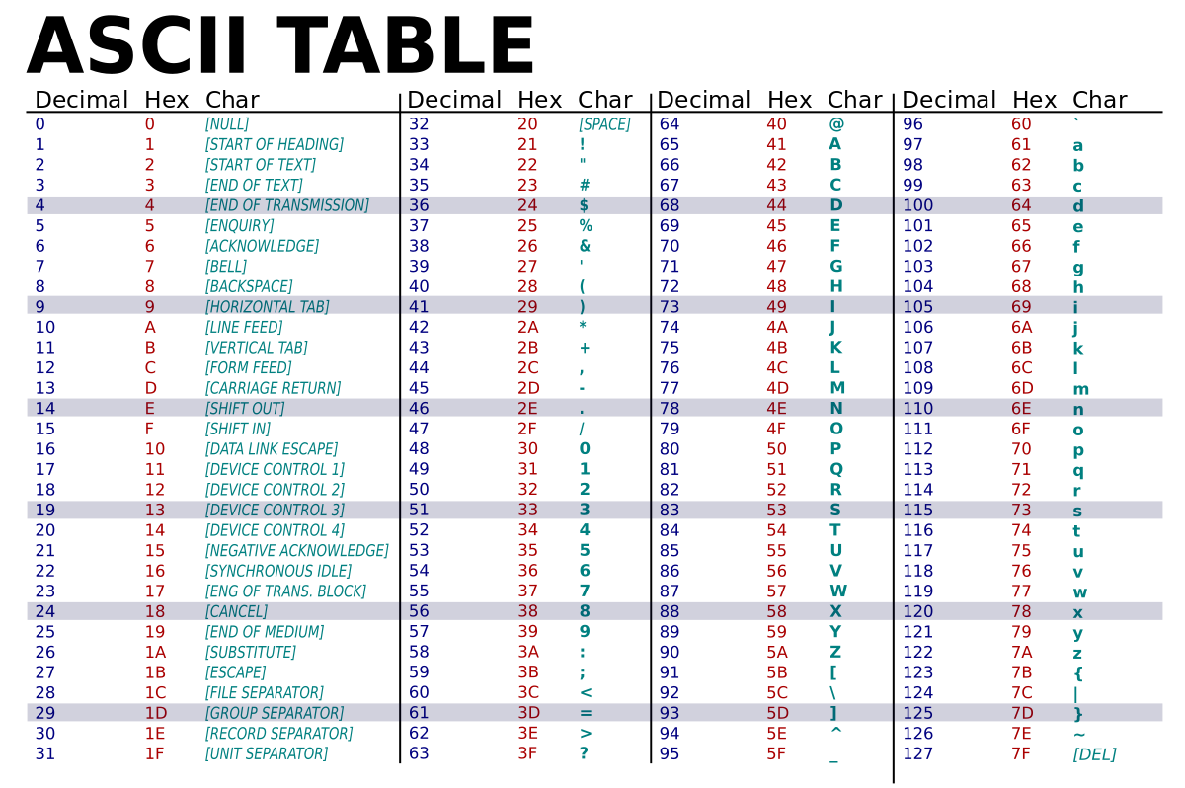
3|
Digital electronic
ASCII
Definition :
American Standard Code for Information Interchange (ASCII) is an alphanumeric code used to transmit letters, symbols, numbers, and special nonprinting characters between computers and computer peripherals (such as printers and keyboards). ASCII consists of 128 different 7-bit codes.

Slide 36
3|
Digital electronic
Digital arithmetic
Logic adder
Logic subtractor
Practice

Slide 37
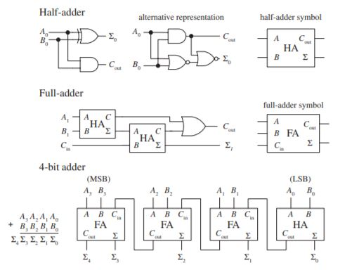
3|
Digital electronic
Logic adder
Definition :
A logic adder is a kind of circuit called arithmetic logic unit (ALU). Adder are made from XOR/AND gates or NOR/AND gates. The most complicate operation a simple adder can do is 1+1. But combined with other adders, it can add more complex numbers.

Slide 38
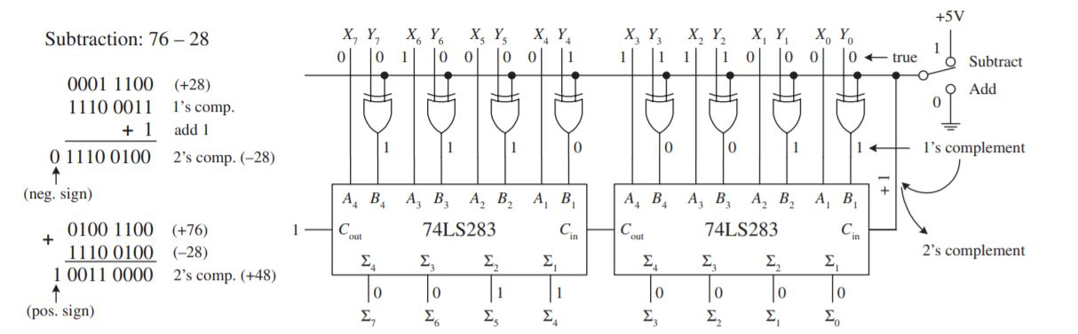
3|
Digital electronic
Logic subtractor
Definition :
A logic adder is a kind of circuit called arithmetic logic unit (ALU). It is possible to use the circuit to perform adding as subtracting. The XOR doesn’t modify anything for adding, but totally invert the binary number for subtracting. Then this number is added to 1 and used to perform and adding operation.

Slide 39
3|
Digital electronic
Practice
Create a full adder with XOR/AND gates.
Then ask other groups to merge your adders in a 4-bit adder

